Slide 1

Affine Loop Optimization using Modulo Unrolling in CHAPEL
Aroon Sharma, Darren Smith, Joshua Koehler, Rajeev Barua, Michael Ferguson

Slide 2
Overall Goal
Improve the runtime of certain types of parallel computers
  In particular, message passing computers
Approach
  Start with an explicitly parallel program
  Use modulo unrolling to minimize communication cost between nodes of the parallel computer
Advantage: Faster scientific and data processing computation
How can this method be applied to other PGAS languages besides Chapel?

Slide 3
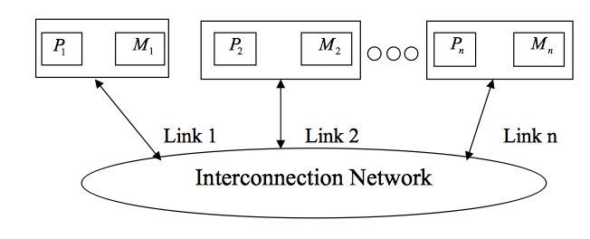
Message Passing Architectures
Communicate data among a set of processors with separate address spaces using messages
  Remote Direct Memory Access (RDMA)
High Performance Computing Systems
100-100,000 compute nodes
Complicates compilation

Slide 4
PGAS Languages
Partitioned Global Address Space (PGAS)
Provides illusion of a shared memory system on top of a distributed memory system
Allows the programmer to reason about locality without dealing with low-level data movement
Example - CHAPEL

Slide 5

CHAPEL
PGAS language developed by Cray Inc.
Programmers express parallelism explicitly
Features to improve programmer productivity
Targets large scale and desktop systems
Opportunities for performance optimizations!

Slide 6
Our Work’s Contribution
We present an optimization for parallel loops with affine array accesses in CHAPEL.
The optimization uses a technique known as modulo unrolling to aggregate messages and improve the runtime performance of loops for distributed memory systems using message passing.
Notes:
The optimization is inspired by a traditional compiler transformation (described in detail in our paper), but its implementation is done directly in the module code for the Chapel data distributions.

Slide 7
Outline
Introduction and Motivation
Modulo Unrolling
Optimized Cyclic and Block Cyclic Dists
Results

Slide 8
Affine Array Accesses
Most common type of array access in scientific codes
  A[i], A[j], A[3], A[i+1], A[i + j], A[2i + 3j]
  A[i, j], A[3i, 5j]
Array accesses are affine if the access on each dimension is a linear expression of the loop indices
  E.g. A[ai + bj + c] for a 2D loop nest
  Where a, b, and c are constant integers

Slide 9
Example Parallel Loop in CHAPEL
forall i in 1..10 do
A[i] = B[i+2];
What happens when the data is distributed?
1
2
3
4
5
6
7
8
9
10
11
12
13
14
15
A:
B:
Notes:
Copying elements from B to A, Shown here in the picture, copying into A an element of B that is two elements over

Slide 10
Data Distributions in CHAPEL
Describe how data is allocated across locales for a given program
  A locale is a unit of a distributed computer (processor and memory)
Users can distribute data with CHAPEL’s standard modules or create their own distributions
Distributions considered in this study
  Cyclic
  Block
  Block Cyclic
Notes:
We don’t override the user’s chosen data distribution. This distribution could have been chosen for reasons unknown to the compiler. What we do want to do is improve the compilation for whatever distribution the user did choose.

Slide 11
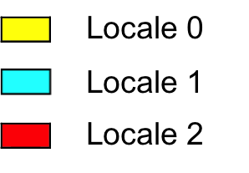
Data Distributions in CHAPEL - Block
use BlockDist;
var domain = {1..15};
var distribution = domain dmapped Block(boundingBox=domain);
var A: [distribution] int;
// A is now distributed in the following fashion
1
2
3
4
5
6
7
8
9
10
11
12
13
14
15
A:

Slide 12
Data Distributions in CHAPEL - Cyclic
use CyclicDist;
var domain = {1..15};
var distribution = domain dmapped Cyclic(startIdx=domain.low);
var A: [distribution] int;
// A is now distributed in the following fashion
1
2
3
4
5
6
7
8
9
10
11
12
13
14
15
A:

Slide 13
Data Distributions in CHAPEL – Block Cyclic
use BlockCycDist;
var domain = {1..15};
var distribution = dom dmapped BlockCyclic(blocksize=3);
var A: [distribution] int;
// A is now distributed in the following fashion
1
2
3
4
5
6
7
8
9
10
11
12
13
14
15
A:
*similar code is used to distributed multi-dimensional arrays

Slide 14
Distributed Parallel Loop in CHAPEL
forall i in 1..10 do
A[i] = B[i+2];
1
2
3
4
5
6
7
8
9
10
11
12
13
14
15
A:
B:
4 Messages
  Locale 1 → Locale 0 containing B[6]
  Locale 1 → Locale 0 containing B[7]
  Locale 2 → Locale 1 containing B[11]
  Locale 2 → Locale 1 containing B[12]

Slide 15
Data Communication in CHAPEL can be Improved
Locality check at each loop iteration
  Is B[i+2] local or remote?
Each message contains only 1 element
We could have aggregated messages
  Using GASNET strided get/put in CHAPEL
  Locale 1 → Locale 0 containing B[6], B[7]
  Locale 2 → Locale 1 containing B[11], B[12]
Growing problem
  Runtime increases for larger problems and more complex data distributions

Slide 16
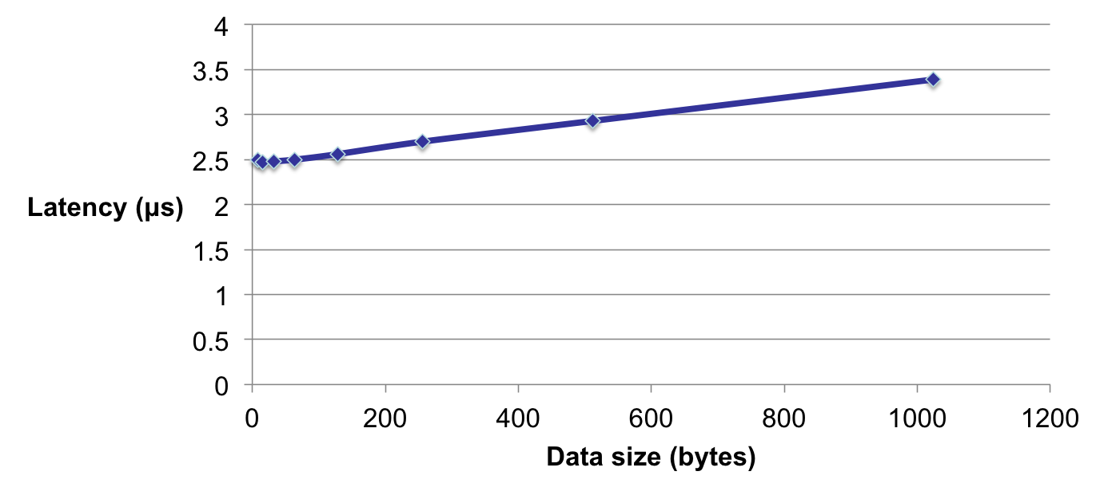
Data Transfer Round Trip Time for Infiniband
Notes:
Much more efficient to communicate big messages than small messages. Bigger messages only take slightly longer so much more efficient to communicate bigger messages

Slide 17
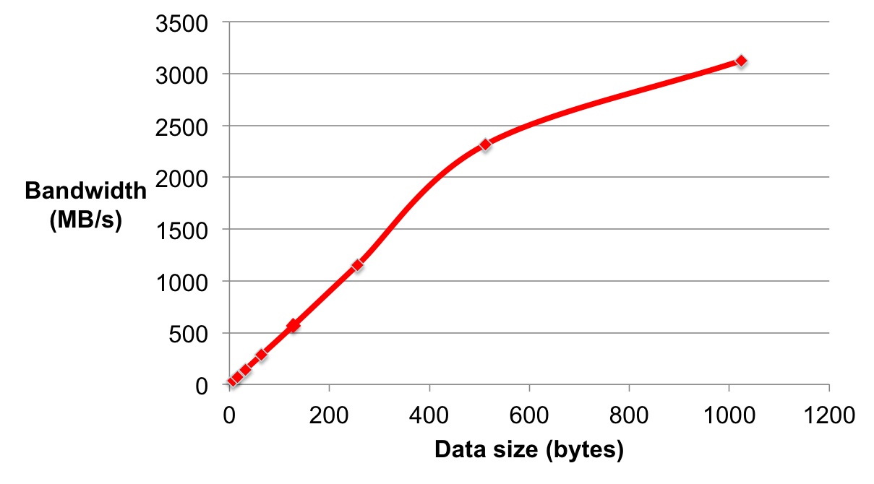
Bandwidth measurements for Infiniband
Notes:
Y axis now bandwidth. Same trend. We want to be to the right on the graph.

Slide 18
How to improve this?
Use knowledge about how data is distributed and loop access patterns to aggregate messages and reduce runtime of affine parallel loops
We are not trying to
  Apply automatic parallelization to CHAPEL
  Come up with a new data distribution
  Bias or override the programmer to a particular distribution
We are trying to
  Improve CHAPEL’s existing data distributions to perform better than their current implementation

Slide 19
Outline
Introduction and Motivation
Modulo Unrolling
Optimized Cyclic and Block Cyclic Dists
Results

Slide 20
Modulo Unrolling – See Barua1999
Method to statically disambiguate array accesses at compile time
Unroll the loop by factor = number of locales
Each array access will reside on a single locale across loop iterations
Intended to improve memory parallelism for tiled architectures in sequential loops
Applicable for Cyclic and Block Cyclic
Notes:
Modulo unrolling developed by Barua for tiled architectures such as MIT Raw computer. We’ve realized that we can apply this to message passing code generation for the first time. We’ve made significant modifications to make it apply.

Slide 21
Modulo Unrolling Example
for i in 1..99 {
A[i] = A[i] + B[i+1];
}
Each iteration of the loop accesses data on a different locale
1
2
3
4
5
6
7
8
9
10
11
12
13
14
15
16
A:
…
B:
…
Locale 3

Slide 22
Modulo Unrolling Example
for i in 1..99 by 4 {
A[i] = A[i] + B[i+1];
A[i+1] = A[i+1] + B[i+2];
A[i+2] = A[i+2] + B[i+3];
A[i+3] = A[i+3] + B[i+4];
}
Loop unrolled by a factor of 4 automatically by the compiler
1
2
3
4
5
6
7
8
9
10
11
12
13
14
15
16
A:
…
B:
…
Locale 3

Slide 23
Modulo Unrolling Example
for i in 1..99 by 4 {
A[i] = A[i] + B[i+1];
A[i+1] = A[i+1] + B[i+2];
A[i+2] = A[i+2] + B[i+3];
A[i+3] = A[i+3] + B[i+4];
}
Locale 0
Locale 1
Locale 2
Locale 3
A[1], A[5], A[9], …
A[2], A[6], A[10], …
A[3], A[7], A[11], …
A[4], A[8], A[12], …
B[1], B[5], B[9], …
B[2], B[6], B[10], …
B[3], B[7], B[11], …
B[4], B[8], B[12], …
1
2
3
4
5
6
7
8
9
10
11
12
13
14
15
16
A:
…
B:
…
Locale 3
How do we apply this concept in Chapel?
Notes:
Every reference always accesses the same locale even as i keeps changing. Happens for all array accesses. Because we have this information, we know where the messages are coming from and we can aggregate messages from the same node.

Slide 24
Outline
Introduction and Motivation
Previous Work
Modulo Unrolling
Optimized Cyclic and Block Cyclic Dists
Results
What about Block?

Slide 25
CHAPEL Zippered Iteration
Iterators
  Chapel construct similar to a function
  return or “yield” multiple values to the callsite
  Can be used in loops
iter fib(n: int) {
var current = 0,
next = 1;
for i in 1..n {
yield current;
current += next;
current <=> next;
}
}
for f in fib(5) {
writeln(f);
}
Being used in a loop
f is the next yielded value of fib after each iteration
Output: 0, 1, 1, 2, 3

Slide 26
CHAPEL Zippered Iteration
Zippered Iteration
  Multiple iterators of the same size are traversed simultaneously
  Corresponding iterations processed together
for (i, f) in zip(1..5, fib(5)) {
writeln(“Fibonacci ”, i, “ = ”, f);
}
Output
Fibonacci 1 = 0
Fibonacci 2 = 1
Fibonacci 3 = 1
Fibonacci 4 = 2
Fibonacci 5 = 3

Slide 27
CHAPEL Zippered Iteration
Can be used with parallel for loops
Leader iterator
  Creates tasks to implement parallelism and assigns iterations to tasks
Follower iterator
  Carries out work specified by leader (yielding elements) usually serially

Slide 28
CHAPEL Zippered Iteration
Follower iterators of A, B, and C will be
responsible for doing work for each task
forall (a, b, c) in zip(A, B, C) {
code…
}
Because it is first, A’s leader iterator
will divide up the work among available tasks
*See Chamberlain2011 for more detail on leader/follower semantics

Slide 29
CHAPEL Zippered Iteration
It turns out any parallel forall loop with affine array accesses can be written using zippered iteration over array slices
forall i in 1..10 {
A[i] = B[i+2];
}
forall (a,b) in zip(A[1..10], B[3..12]){
a = b;
}
Zippered iteration
Implement modulo unrolling and message aggregation within the leader and follower iterators of the Block Cyclic and Cyclic distributions!

Slide 30
Modulo Unrolling in CHAPEL Cyclic Distribution
forall (a,b) in zip(A[1..10], B[3..12]) do
a = b;
1
2
3
4
5
6
7
8
9
10
11
12
13
14
15
16
A:
…
B:
…
Locale 3
*if yielded elements are written to during the loop, a similar bulk put message is required to update remote portions of array
Leader iterator allocates locale 0 with iterations 1, 5, 9, …
Follower iterator of B recognizes that its work 3, 7, 11, … is remote on locale 2
Elements of B’s chunk of work brought to locale 0 via 1 bulk get message to a local buffer
Elements of local buffer are now yielded back to loop header
Locale 0

Slide 31
Modulo Unrolling in CHAPEL Block Cyclic Distribution
forall (a,b) in zip(A[1..10], B[3..12]) do
a = b;
1
2
3
4
5
6
7
8
9
10
11
12
13
14
15
16
A:
…
B:
…
Locale 3
Aggregation now occurs with elements in the same location within each block
Both leader and follower needed to be modified
Locale 0

Slide 32
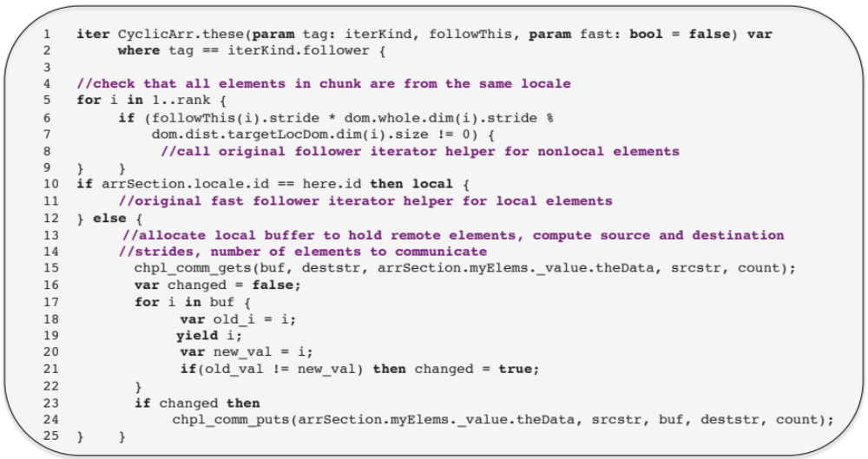
Cyclic Follower Implementation
Notes:
Here is the implementation of Chapel Cyclic distribution’s follower iterator with modulo unrolling with some coding details left out for brevity.
Each follower iterator call is associated with a chunk of parallel work divided up by the leader iterator. Because a leader can divide up loop iterations in a number of ways, there are 3 ways this chunk of work can be distributed:
Entirely local – yield elements locally (lines 10 and 11)
Nonlocal where elements reside on different locales – fall back to original follower implementation (lines 4-9)
Entirely nonlocal from a single locale – (lines 12-25) If this case is true, then the elements in the chunk must be separated by fixed stride(s) because the dist is Cyclic
Make a single strided get message to retrieve elements in the chunk of work and store them in a local buffer
Yield elements from the local buffer
If elements are written to during the loop, make a single strided put message to store back elements to the remote locale (lines 16-25)
The Block Cyclic follower implementation is identical.
The Block Cyclic leader iterator implementation is responsible for dividing up the work into multiple cyclic chunks so that the same logic for case 3 can be applied

Slide 33
Outline
Introduction and Motivation
Previous Work
Modulo Unrolling
Optimized Cyclic and Block Cyclic Dists
Results

Slide 34
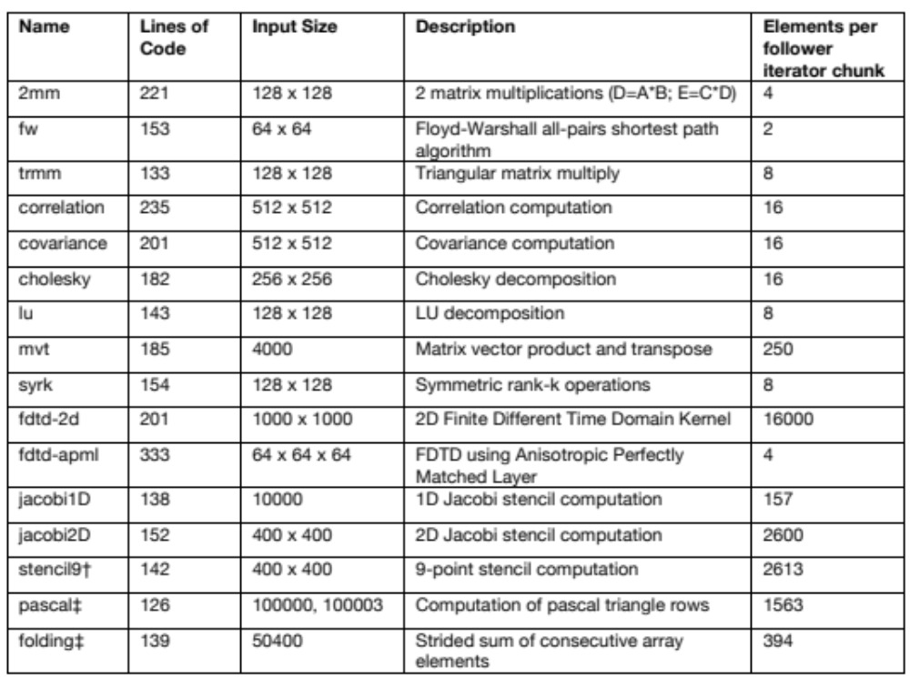
Benchmarks
* Data collected on 10 node Golgatha cluster at LTS

Slide 35
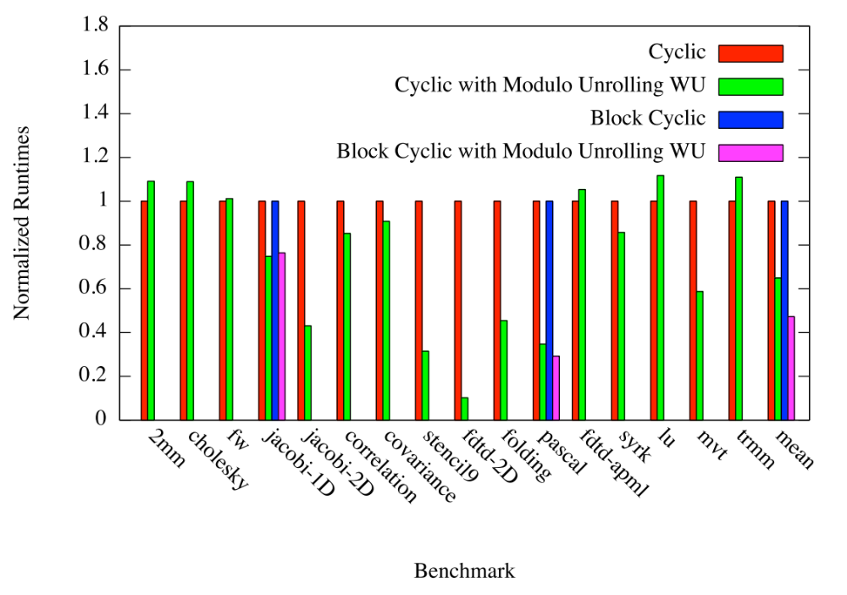
Runtime Comparisons
Notes:
10/16 benchmarks distributed cyclically improved in runtime when modulo unrolling was used
2/2 benchmarks distributed block cyclically improved in runtime when modulo unrolling was used

Slide 36
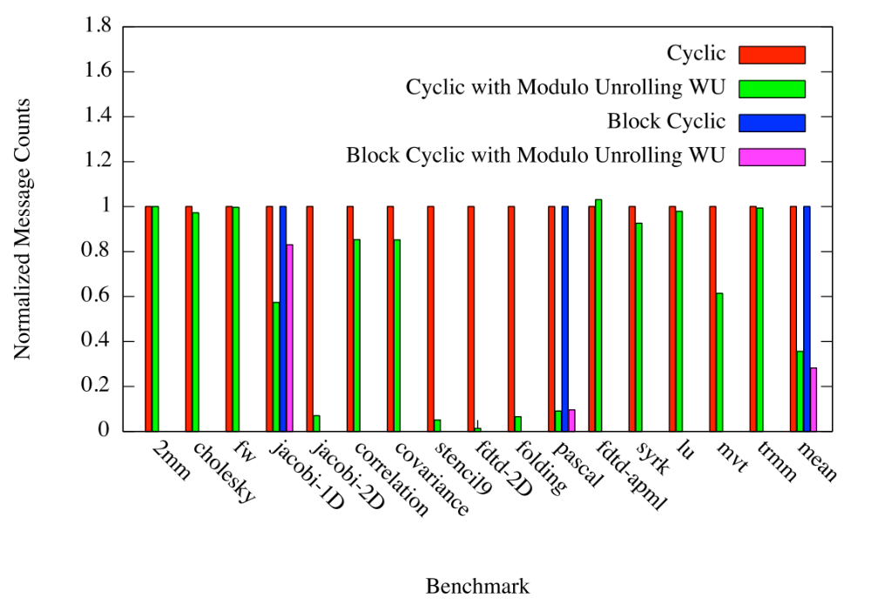
Message Count Comparisons

Slide 37
Overall Improvement of Modulo Unrolling
On average Cyclic with modulo unrolling results in
  36% reduction in runtime
  64% fewer messages
On average Block Cyclic with modulo unrolling results in
  53% reduction in runtime
  72% fewer messages

Slide 38
Conclusion
We’ve presented optimized Cyclic and Block Cyclic distributions in CHAPEL that perform modulo unrolling
Our results for Cyclic Modulo and Block Cyclic Modulo show improvements in runtime and message counts for affine programs

Slide 39
Future Work
Scalability Testing
  Strong (Varying number of locales)
  Weak (Varying the input sizes)
  Block Size
Add dynamic checks to determine when to turn on/off modulo unrolling to achieve better overall speedups
Experiment with non-blocking communication schemes to overlap communication and computation

Slide 40
Questions?

Slide 41
Backup Slides

Slide 42
References
[1] Barua, R., & Lee, W. (1999). Maps: A Compiler-Managed Memory System for Raw Machine. Proceedings of the 26th International Symposium on Computer Architecture, (pp. 4-15).
[2] User-Defined Parallel Zippered Iterators in Chapel, Chamberlain, Choi, Deitz, Navarro; October 2011
[3] M.-W. Benabderrahmane, L.-N. Pouchet, A. Cohen, and C. Bastoul. The polyhedral model is more widely applicable than you think. In ETAPS International Conference on Compiler Construction (CC’2010), pages 283–303, Mar. 2010.

Slide 43
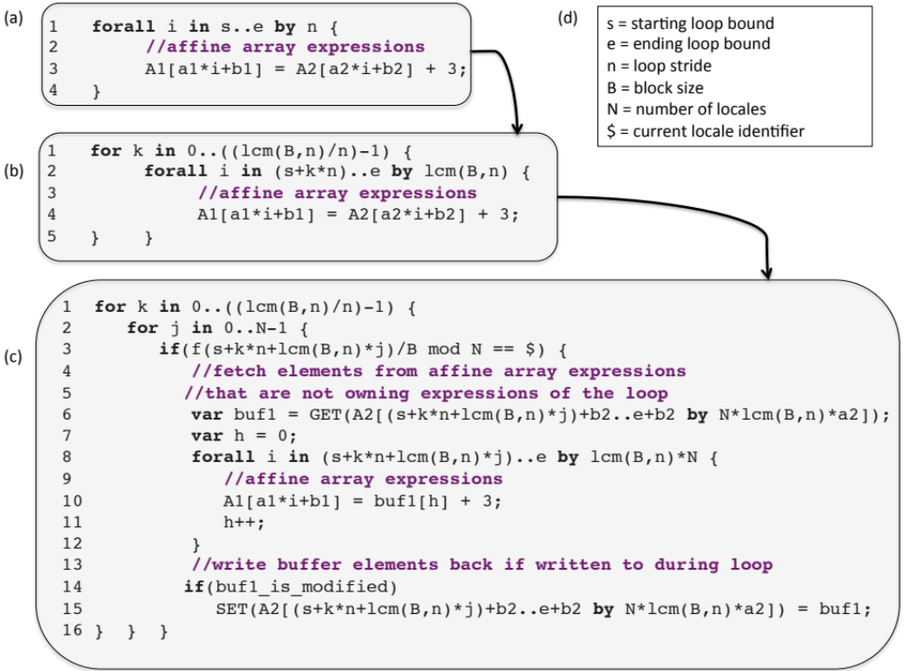
Pseudocode of Compiler Transformation

Slide 44
References
[4] Compile-time techniques for data distribution in distributed memory machines. J Ramanujam, P Sadayappan - Parallel and Distributed Systems, IEEE Transactions on, 1991
[5] Chen, Wei-Yu, Costin Iancu, and Katherine Yelick. "Communication optimizations for fine-grained UPC applications." Parallel Architectures and Compilation Techniques, 2005. PACT 2005. 14th International Conference on. IEEE, 2005.

Slide 45
What about Block?
Our method does not help the Block distribution
  Reason: Needs cyclic pattern
For Block, we use the traditional method

Slide 46
What about Block?
2D Jacobi Example – Transformed Pseudocode
For each block in parallel
forall (k1,k2) in {0..1, 0..1} {
if A[2 + 3k1, 2 + 3k2].locale.id == $ then on $ {
buf_north = get(A[2+3k1..4+3k1, 2+3k2-1..4+3k2-1]);
buf_south = get(A[2+3k1..4+3k1, 2+3k2+1..4+3k2+1]);
buf_east = get(A[2+3k1-1..4+3k1-1, 2+3k2..4+3k2]);
buf_west = get(A[2+3k1+1..4+3k1+1, 2+3k2..4+3k2]);
LB_i = 2+3k1;
LB_j = 2+3k2;
forall(i, j) in {2+3k1..4+3k1, 2+3k2..4+3k2} {
A_{new}[i,j] = (buf_north[i-LB_i, j-LB_j] + buf_south[i-LB_i, j-LB_j] +
buf_east[i-LB_i, j-LB_j] + buf_west[i-LB_i, j-LB_j])/4.0;
}
}
Bring in remote
portions of array
footprint locally
Do the computation using local buffers

Slide 47
What about Block?
It seems that data distributed using Block naturally results in fewer messages for many benchmarks
Makes sense because many benchmarks in scientific computing access nearest neighbor elements
Nearest neighbor elements are more likely to reside on the same locale
Could we still do better and aggregate messages?

Slide 48
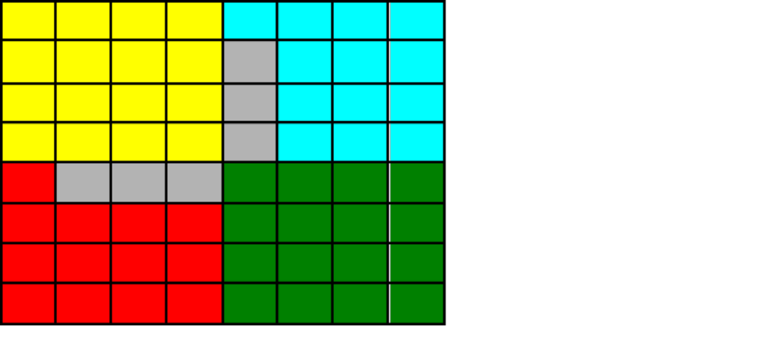
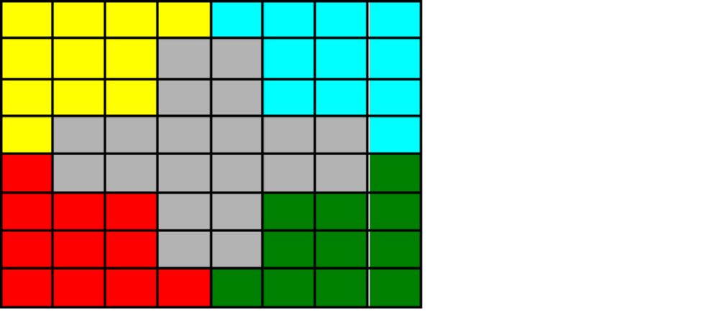
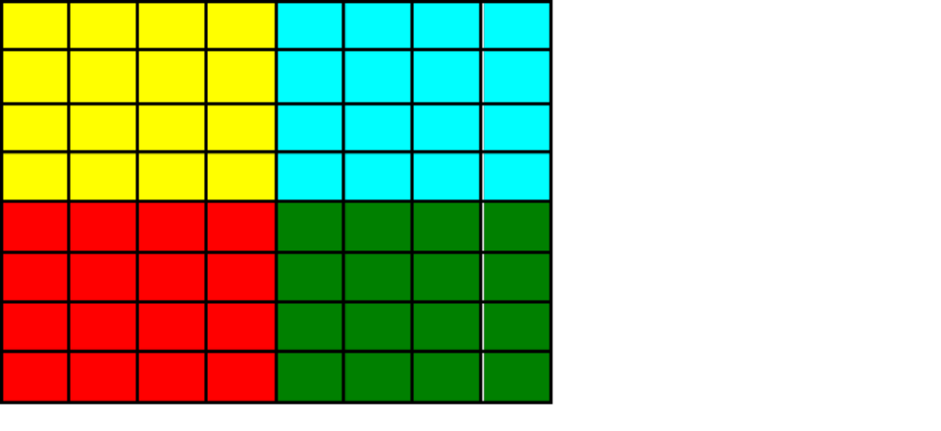
What about Block?
2D Jacobi Example
2 remote blocks per locale → 2 messages
8 messages with aggregation
24 messages without
Messages without aggregation grows as problem size grows
i
1
2
3
4
5
6
7
8
1
2
j
3
4
5
Locale 3
6
7
8
A[i, j-1]
A[i-1, j]
A[i, j]
A[i+1, j]
forall (i,j) in {2..7, 2..7} {
A_{new}[i,j] = (A[i+1, j] + A[i-1, j] + A[i, j+1] + A[i, j-1])/4.0;
}
A[i, j+1]

Slide 49
LTS Golgatha Cluster Hardware Specs
10 hardware nodes
Infiniband communication layer between nodes
2 sockets per node
Intel Xeon X5760 per socket
  2.93GHz
  6 cores (12 hardware threads w/ 2 way hyperthreading)
  24GB RAM per processor

